Slide 1
Chapter 1
INTRODUCTION TO SUPPLY CHAIN MANAGEMENT
Prepared by Cynthia Wisner, MBA

Slide 2
Chapter 1 Learning Objectives
You should be able to:
Describe a supply chain and define supply chain management.
Describe the objectives and elements of supply chain management.
Describe basic supply chain management activities.
Describe a brief history and current trends of supply chain management.
Understand the bullwhip effect and how it impacts supply chain.

Slide 3
Chapter Outline
Introduction
Supply Chain Management Defined
The Importance of Supply Chain Management
The Origins of Supply Chain Management in the U.S.
The Foundations of Supply Chain Management
Current Trends in Supply Chain Management

Slide 4
What is a Supply Chain?, Part 1
A supply chain consists of the flow of products and services from:
Raw materials manufacturers
Component and intermediate manufacturers
Final product manufacturers
Wholesalers and distributors and
Retailers
Connected by transportation and storage activities, and
Integrated through information, planning, and integration activities
Today large firms are moving away Vertically Integrated due to high cost and difficulty managing diverse units

Slide 5
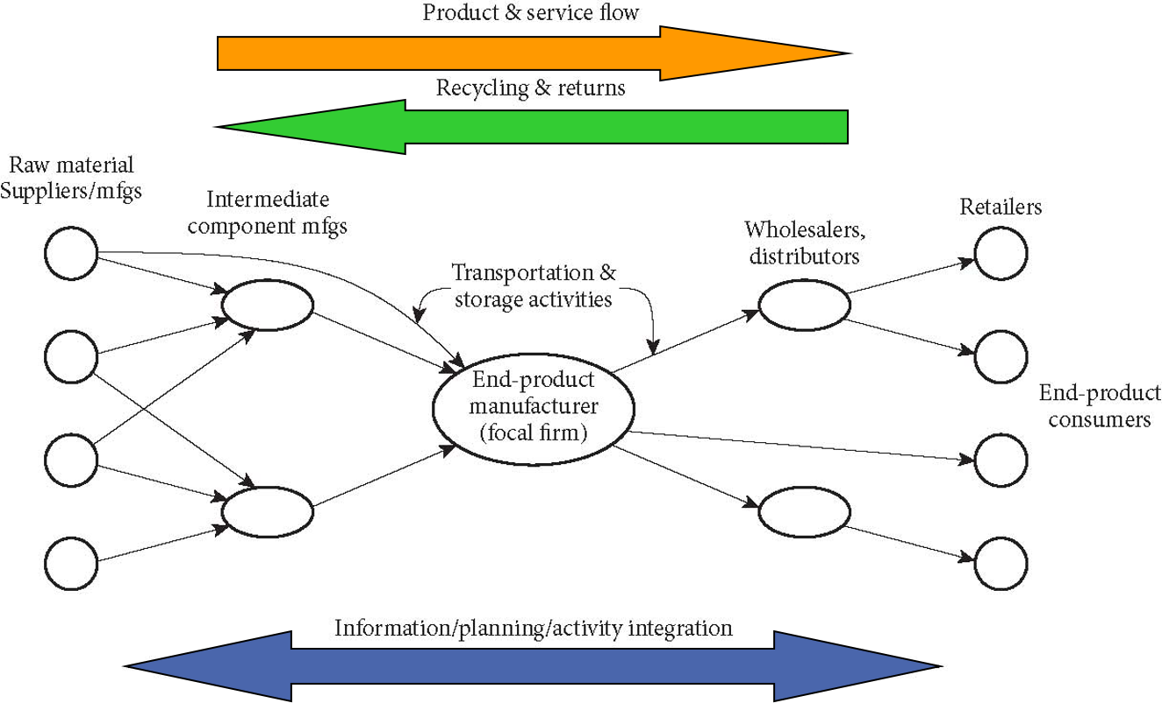
What is a Supply Chain?, Part 2

Slide 6
What is Supply Chain Management?, Part 1
The planning and management of all activities involved in sourcing and procurement, conversion, and all logistics management activities … also includes coordination with channel partners, which can be suppliers, intermediaries, third party service providers, and customers.
Council of Supply Chain Management Professionals
The design and management of seamless, value-added processes across organizational boundaries to meet the real needs of the end customer.
Institute for Supply Management
The design, planning, execution, control and monitoring of supply chain activities with the objective of creating net value, building a competitive infrastructure, leveraging worldwide logistics, synchronizing supply with demand, and measuring performance globally.
Association for Operations Management

Slide 7
What is Supply Chain Management?, Part 2
Traditional organizational cultures that emphasized short-term, company focused performance can conflict with the objectives of supply chain management
Successful supply chain management requires high levels of trust, cooperation, collaboration, and honest, accurate communications
All participants in the supply chain benefit.
Boundaries are dynamic and extend from “the firm’s suppliers’ suppliers to its customers’ customers (i.e., second tier suppliers and customers).”
Supply chains also include reverse logistics activities to handle returned products, warranty repairs, and recycling.

Slide 8
Importance of Supply Chain Management, Part 1
Firms with large system inventories gain the most from successful SCM
Lower purchasing & carrying costs
Better product quality
Higher customer service levels
Increased sales and profits

Slide 9
Importance of Supply Chain Management, Part 2
Firms using Supply Chain Management:
Start with key suppliers
Move on to other suppliers, customers, and logistics services
Integrate second tier suppliers and customers (second tier refers to the customer’s customers and the supplier’s suppliers)

Slide 10
Importance of Supply Chain Management, Part 3
Cost savings and better coordination of resources are reasons to employ Supply Chain Management
Reduced Bullwhip Effect
Defined as: Erratic demand forecasts causing excess safety stocks, which cause production planning problems.
SCM reduces safety stocks and costs due to coordinated planning and better sharing of information

Slide 11
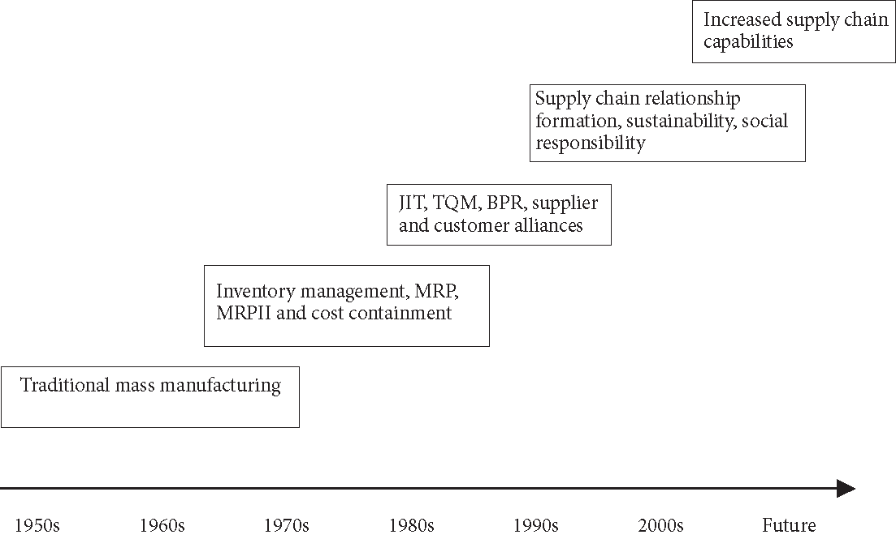
Origins of Supply Chain Management, Part 1

Slide 12
Origins of Supply Chain Management, Part 2
1950s-1960s
U.S. manufacturers focused on mass production techniques as their principal cost reduction and productivity improvement strategies
1960s-1970s
Introduction of new computer technologies lead to development of Materials Requirements Planning (MRP) and Manufacturing Resource Planning (MRPII) to coordinate inventory management and improve internal communication

Slide 13
Origins of Supply Chain Management, Part 3
1980s-1990s
Intense global competition led U.S. manufacturers to adopt:
Supply Chain Management (SCM)
Just-In-Time (JIT)
Total Quality Management (TQM)
Business Process Reengineering (BPR)
Customer Relationship Management (CRM)

Slide 14
Origins of Supply Chain Management, Part 4
2000s and Beyond
Evolution along 2 parallel paths
Supply management emphasis from industrial buyer
Logistics and customer service emphasis from wholesalers and retailers
Focus on improving supply chain capabilities with initiatives such as:
Third-party service providers (3PLs)
Integrating logistics
Client/server SCM software - Enterprise Resource Planning

Slide 15
Origins of Supply Chain Management, Part 5
Today
Emphasis is being placed on the environmental and social impacts of supply chains
Sustainability - ability to meet the needs of current supply chain members without hindering the ability to meet the needs of future generations
Triple bottom line – taking care of people, planet and profits

Slide 16
The Foundations of Supply Chain Management, Part 1
Supply | Supply base reduction, supplier alliances, SRM, global sourcing, ethical and sustainable sourcing (Ch. 2-4)
Operations | Demand management, CPFR, inventory management, MRP, ERP, lean systems, Six Sigma quality systems (Ch. 5-8)
Logistics | Logistics management, customer relationship management, network design, RFID, global supply chains, sustainability, service response logistics (Ch. 9-12)
Integration | Barriers to integration, risk and security management, performance measurement, green supply chains (Ch. 13,14)

Slide 17
The Foundations of Supply Chain Management, Part 2
Supply Elements:
Supplier management - improve performance through
Supplier evaluation (determining supplier capabilities)
Supplier certification (third party or internal certification to assure product quality and service requirements)
Strategic partnerships - successful and trusting relationships with top-performing suppliers
Ethics and sustainability – recognizing suppliers’ impact on reputation and carbon footprint

Slide 18
Important Elements of Supply Chain Management, Part 1
Operations Elements:
Demand management - match demand to available capacity
Linking buyers & suppliers via MRP and ERP systems
Extending order communication and inventory visibility farther up the supply chain
Radio frequency identification (RFID) systems scan cartons describing contents of the packages
Use lean systems to improve the flow of materials to reduce inventory levels
Employ Six Sigma to improve quality compliance among suppliers

Slide 19
Important Elements of Supply Chain Management, Part 2
Logistics Elements:
Transportation management - tradeoff decisions between cost & timing of delivery / customer service via trucks, rail, water & air
Third party logistics providers (3PLs) – for hire outside agencies providing transportation and services
Creating distribution networks based on tradeoff decisions between cost & sophistication of distribution system

Slide 20
Important Elements of Supply Chain Management, Part 3
Integration Elements:
Supply Chain Process Integration - when supply chain participants work for common goals. Requires intra-firm functional integration, with efforts to change attitudes & adversarial relationships
Supply Chain Performance Measurement - Crucial for firms to know if procedures are working as expected
High level supply chain performance occurs when strategies at each firm fit well with overall supply chain strategies

Slide 21
Current Trends in Supply Chain Management, Part 1
Supply Chain Analytics - examining raw supply chain data and reaching conclusions or making predictions with the information
Growth being pushed by the rise in computing capabilities and big data
Huge volumes of data generated in business organizations including retail, healthcare, manufacturing, and electronics

Slide 22
Current Trends in Supply Chain Management, Part 2
Most companies are trying to improve their supply chain sustainability performance
Can lead to
enhance processes
reduce costs
increase productivity
uncover product innovation
achieve market differentiation
improve societal outcomes

Slide 23
Current Trends in Supply Chain Management, Part 3
Increasing Supply Chain Visibility
Knowing exactly where products are, at any point in the supply chain
Inventory visibility is made easier by technology
Sophisticated software applications for tracking orders, inventories, deliveries, returned goods, and even employee attendance

Slide 24

End of Chapter 1

